Slide 1
CS 455 – Computer Graphics
Three-Dimensional Transformations

Slide 2
3D Space
We want to extend the idea of transformations to deal with 3D objects
More complex than 2D, but essentially the same ideas work
Coordinate systems:
We will use a right-handed system
y
y
z
x
z
x
Left-handed
Right-handed

Slide 3
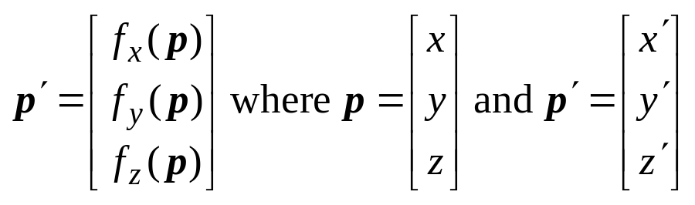
General 3-D Transformations
A general 3-D transformation has the form:
  x´ = f_{x}(x, y, z)
  y´ = f_{y}(x, y, z)
  z´ = f_{z}(x, y, z)
  where x, y, and z are the original coordinates and x´, y´, and z´ are the transformed coordinates
  In vector form:

Slide 4
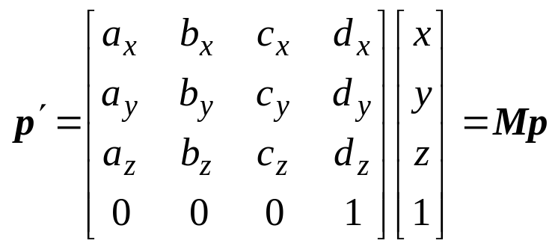
Affine Homogeneous Transformations
For the same reason as 2-D, we want to use affine transformations in homogeneous coordinates:
  x´ = f_{x} (x, y, z, 1) = a_{x}x + b_{x}y + c_{x}z + d_{x}
  y´ = f_{y} (x, y, z, 1) = a_{y}x + b_{y}y + c_{y}z + d_{y}
  z´ = f_{z} (x, y, z, 1) = a_{z}x + b_{z}y + c_{z}z + d_{z}
  w´ = f_{w}(x, y, z, 1) = 1
  In matrix form:
Homogeneous
coordinate (w = 1)

Slide 5
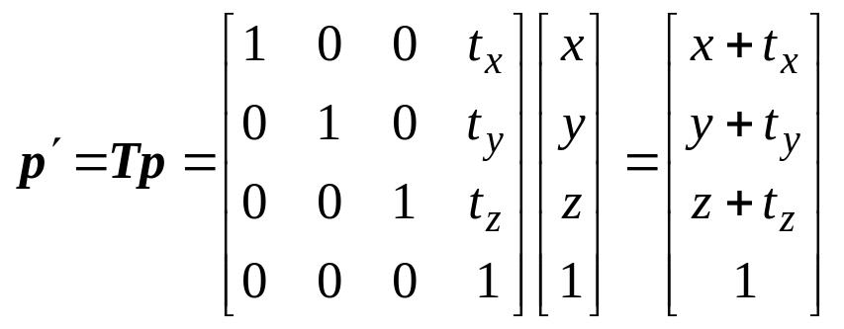
Translation
Move a 3-D object from one place to another:
  Simple extension from 2-D to 3-D → add a translation for z

Slide 6
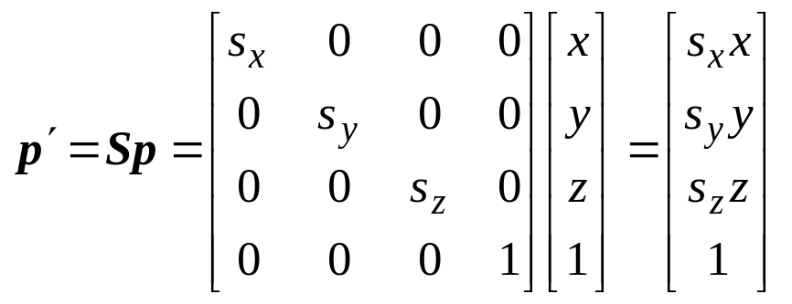
Scale
Change a 3-D object’s size:
  Another simple extension → add a scale for z

Slide 7
Rotation
More involved than translation or scale.
We need to rotate about a particular coordinate axis
Positive rotations will be such that looking down one coordinate axis, a 90 degree counter-clockwise rotation will transform one positive axis into another
Axis of rotation
x
y
z
Direction of positive rotation
y to z
z to x
x to y
y
x
z

Slide 8
Rotation: About a Coordinate Axis
Three possible axes to rotate about:
x axis: p´ = R_{x} p
y axis: p’ = R_{y} p
z axis : p’ = R_{z} p
We will need a separate rotation matrix for each case

Slide 9
Rotation about the x axis
Looking down the x axis:
We want to rotate from p to p’
We know:
  y = r cos φ z= r sin φ
  x’ = x y’ = r cos(φ + θ) z’ = r sin(φ + θ)
p(x, y, z)
y
p’(x’, y’, z’)
φ
θ
z

Slide 10
Rotation about the x axis (cont)
The sum of angles formula:
  cos(φ + θ) = cosφ cos θ - sinφ sinθ
  sin(φ + θ) = sinφ cos θ + cos φ sinθ
So:
p(x, y, z)
y
p’(x’, y’, z’)
φ
θ
z
  x’ = x
  y = r cos φ
  z= r sin φ
  x’ = x
  y’ = r cos(φ + θ)
  z’ = r sin(φ + θ)
  y’ = r cosφ cosθ - r sinφ sinθ
  = y cosθ - z sinθ
  z’ = r sinφ cosθ + r cosφ sin θ
  = z cosθ + y sinθ

Slide 11
Rotation about the x axis (cont)
So:
  p’ = (x’, y’, z’, 1)
  = R_{x}(θ) • p
  = (x, y cosθ - z sinθ, y sinθ + z cosθ , 1)
So

Slide 12
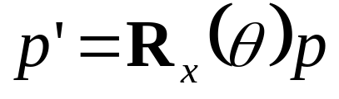
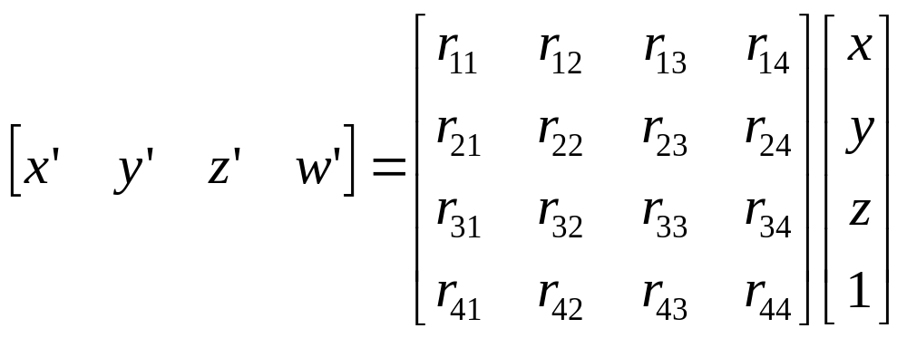
Rotation about the x axis (cont)
So what is R_{x}(θ)?
We need:

Slide 13
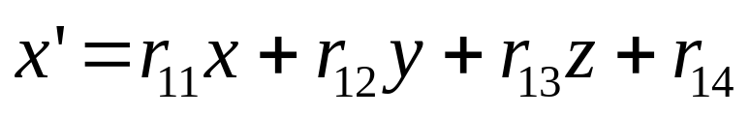
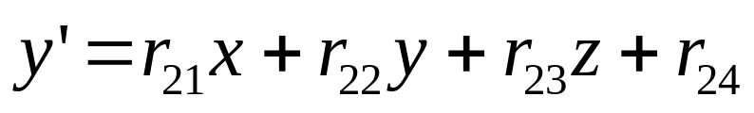
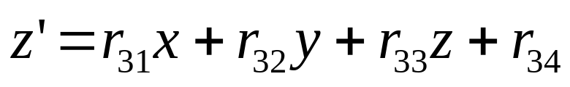
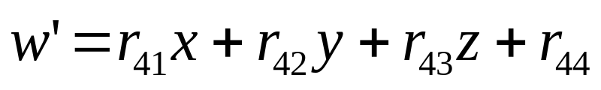
Rotation about the x axis (cont)
Multiplying gives:

Slide 14

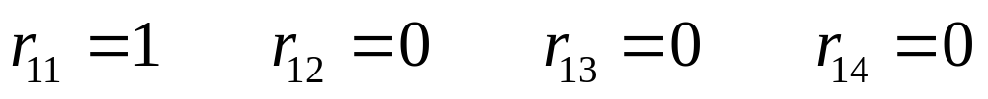
Rotation about the x axis (cont)
From our calculations:
So:

Slide 15
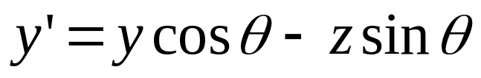
Rotation about the x axis (cont)
From our calculations:
So:

Slide 16
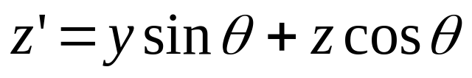
Rotation about the x axis (cont)
From our calculations:
So:

Slide 17

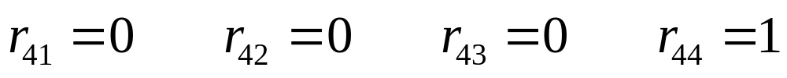
Rotation about the x axis (cont)
From our calculations:
So:

Slide 18
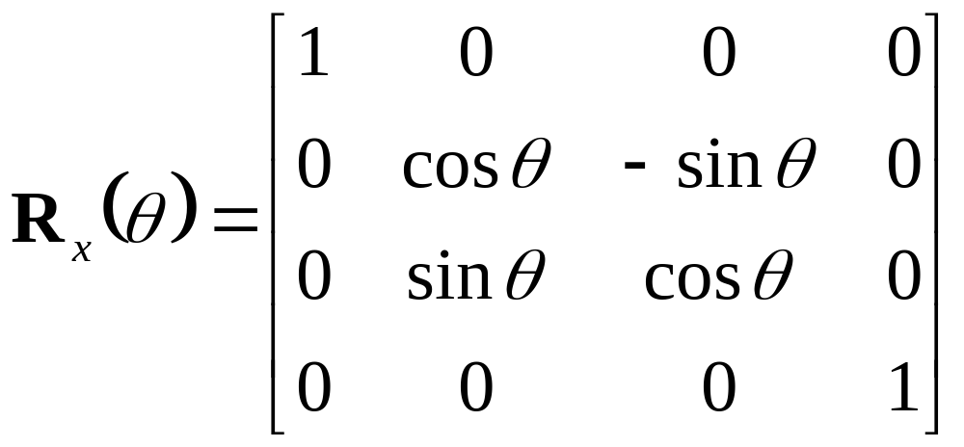
Rotation about the x axis (cont)
So:
Giving:

Slide 19
Rotation about the y axis
Looking down the y axis:
In this case:
  x = r sin φ z= r cos φ
  x’ = r sin(φ + θ) y’ = y z’ = r cos(φ + θ)
p(x, y, z)
z
p’(x’, y’, z’)
φ
θ
x

Slide 20
Rotation about the y axis (cont)
So:
p(x, y, z)
z
  x’ = r sinφ cosθ + r cosφ sin θ
  = x cosθ + z sinθ
φ
p’(x’, y’, z’)
θ
  y’ = y
x
  x = r sin φ
  z= r cos φ
  x’ = r sin(φ + θ)
  y’ = y
  z’ = r cos(φ + θ)
  z’ = r cosφ cosθ - r sinφ sinθ
  = z cosθ - x sinθ

Slide 21
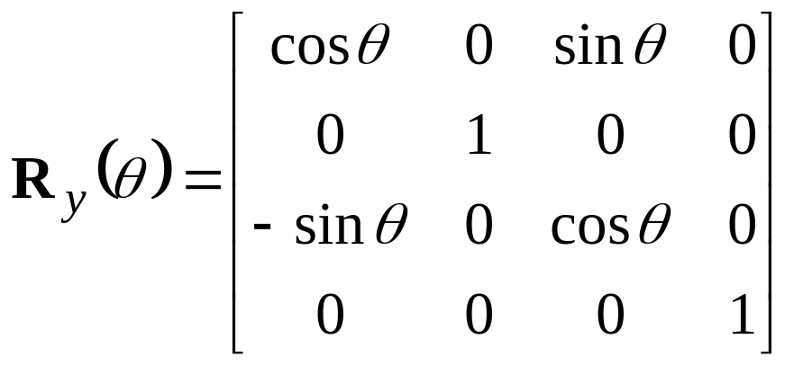
Rotation about the y axis (cont)
So:
  p’ = (x’, y’, z’, 1)
  = R_{y}(θ) • p
  = (x cosθ + z sinθ, y, z cosθ - x sinθ, 1)
So what is R_{y}(θ)?

Slide 22
Rotation about the z axis
Looking down the z axis:
In this case:
  x = r cos φ y = r sin φ
  x’ = r cos(φ + θ) y’ = r sin(φ + θ) z’= z
y
p’(x’, y’, z’)
θ
p(x, y, z)
φ
x

Slide 23
Rotation about the z axis (cont)
y
So:
p’(x’, y’, z’)
  x’ = r cosφ cosθ - r sinφ sinθ
  = x cosθ - y sinθ
θ
p(x, y, z)
φ
x
  y’ = r sinφ cosθ + r cosφ sin θ
  = y cosθ + x sinθ
  x = r cos φ
  y = r sin φ
  x’ = r cos(φ + θ)
  y’ = r sin(φ + θ)
  z’= z
  z’= z

Slide 24
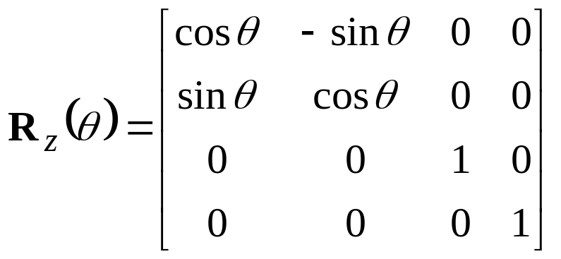
Rotation about the z axis (cont)
So:
  p’ = (x’, y’, z’, 1)
  = R_{z}(θ) • p
  = (x cosθ - y sinθ, y, y cosθ + x sinθ, 1)
So what is R_{z}(θ)?

Slide 25
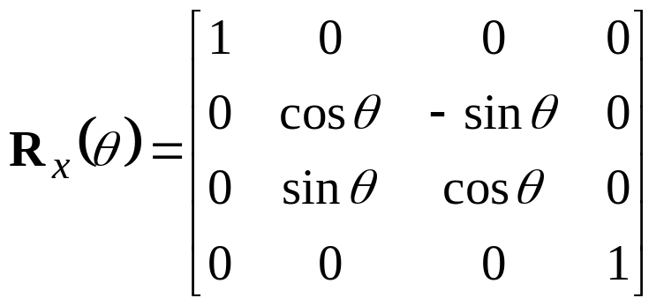
Rotation About Coordinate Axes Summary
Rotate about x-axis
Rotate about y-axis
Rotate about z-axis

Slide 26
Rotation: About Arbitrary Axis
Want to rotate θ degrees about some line l : p’ = R_{l} p
We know how to rotate about the axes, so we need to transform this into a situation we know how to handle
y
l
z
x

Slide 27
Rotation: About Arbitrary Axis
Basic Idea:
  Move a point on the line to the origin
  Rotate about some axis to put l into a coordinate plane
  Rotate about another axis to align l with a coordinate axis
  Rotate about that axis by θ
  Reverse rotation about the coordinate axis in step 3
  Reverse rotation about the coordinate axis in step 2
  Reverse translation from step 1

Slide 28
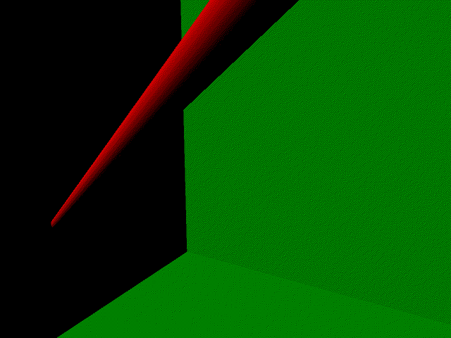
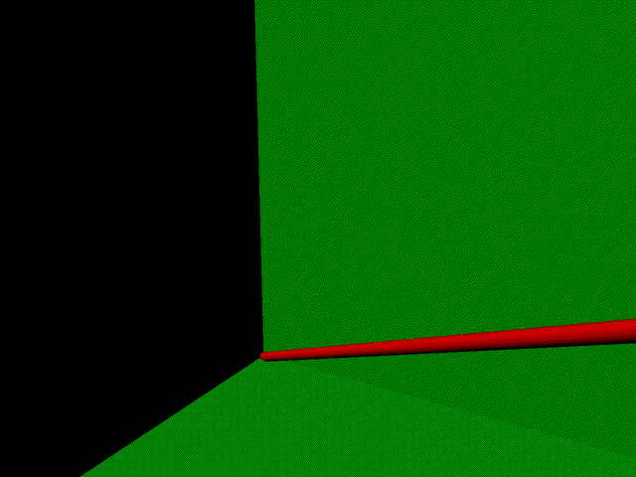
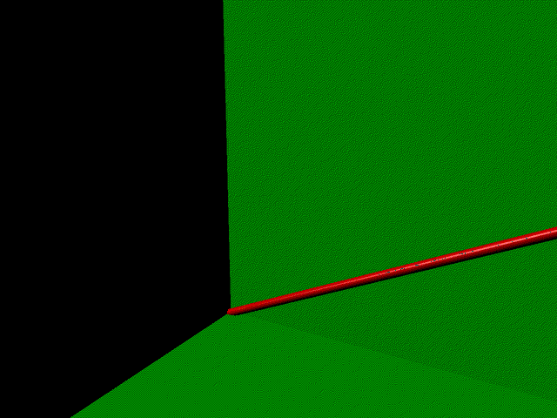
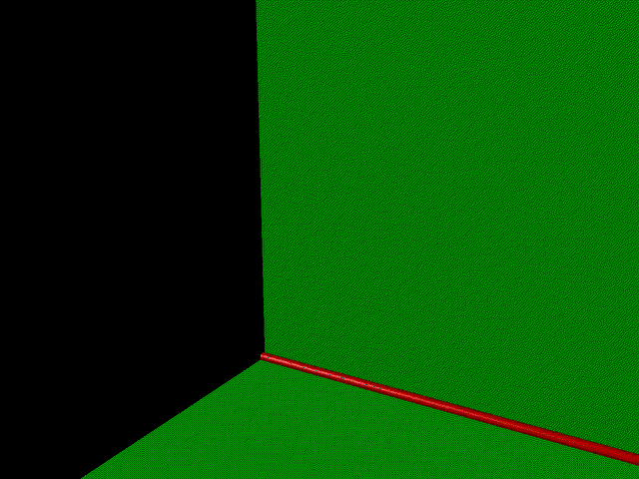

Slide 29
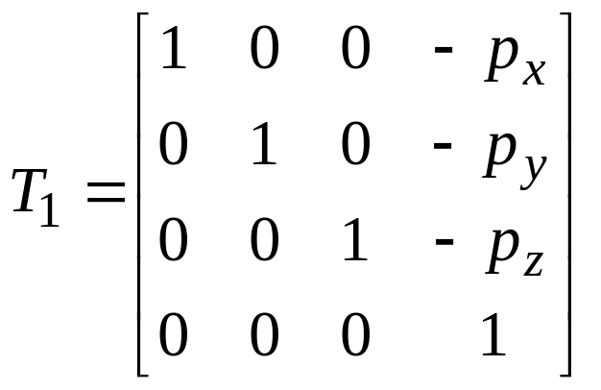
Rotation About Arbitrary Axis: step 1
Translate to get a point on l to the origin:
y
y
l
p = (p_{x}, p_{y}, p_{z})
l
z
x
z
x

Slide 30
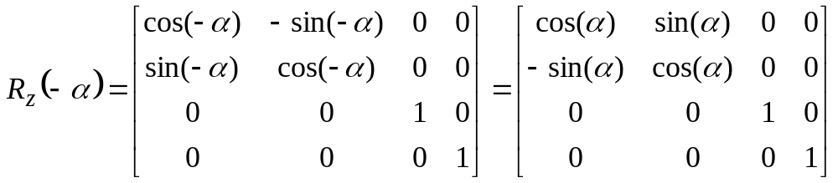
Rotation About Arbitrary Axis: step 2
Rotate to get l into a coordinate plane.
In this example, rotate -α about the z axis to put the line in the xz plane:
y
y
l
−α
z
x
z
l
x

Slide 31
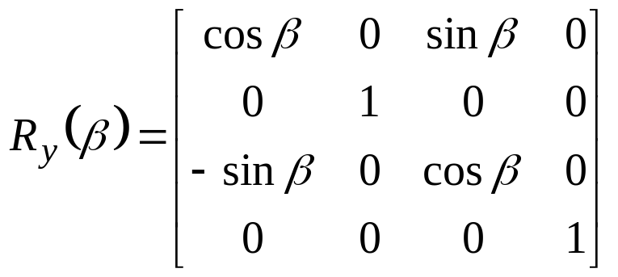
Rotation About Arbitrary Axis: step 3
Rotate to get l onto a coordinate axis.
In this example, rotate β about the y axis to put line on x axis:
y
y
l
β
x
x
z
z
l

Slide 32
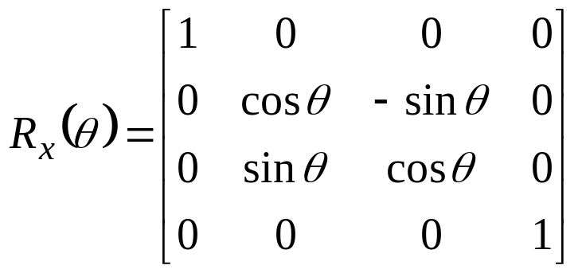
Rotation About Arbitrary Axis: step 4
Perform desired rotation (rotate by θ about x)
y
y
θ
l
l
z
x
x
z

Slide 33
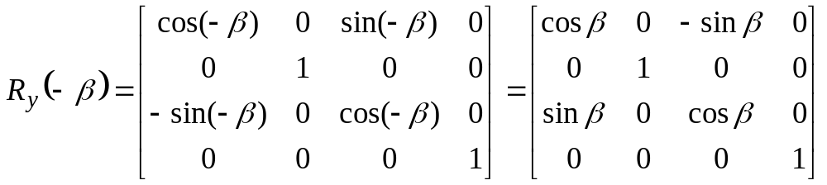
Rotation About Arbitrary Axis: step 5
Perform inverse rotation to get l back into coordinate plane: rotate -β about the y axis to put line in xz plane:
y
y
l
x
z
x
z
−β
l

Slide 34
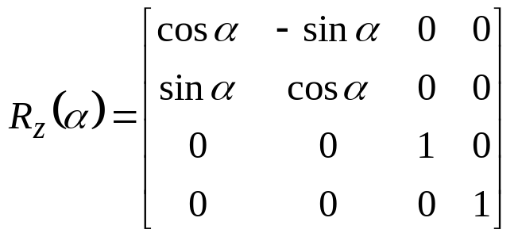
Rotation About Arbitrary Axis: step 6
Perform inverse rotation to take l out of coordinate plane: rotate α about z:
y
y
l
α
x
z
x
z
l

Slide 35
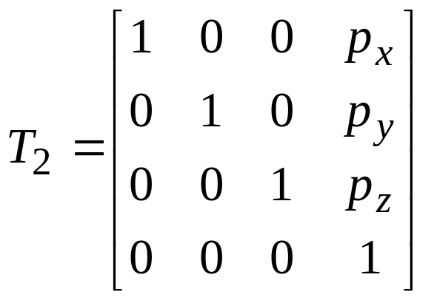
Rotation About Arbitrary Axis: step 7
Invert the initial translation to get the point at the origin back to its original location:
y
y
l
l
p = (p_{x}, p_{y}, p_{z})
z
x
z
x

Slide 36
Rotation About Arbitrary Axis: summary
The complete transformation for this example to rotate about an arbitrary axis is:
Once you have this matrix, you apply it to each point on the object, which has the effect of rotating that object about the arbitrary axis

Slide 37
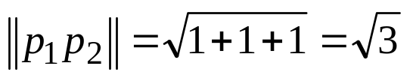
Rotation About Arbitrary Axis: example
Specific Example: rotate object about the line passing through (1, 3, 2) and (2, 4, 3) by the angle of θ
Note:
Length does not change with R or T
y
l
p₂ = (2, 4, 3)
p₁ = (1, 3, 2)
z
x

Slide 38
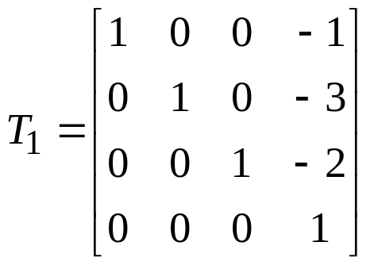
Rotation example (step 1)
Step 1: Translate point to origin
y
y
l
l
p₂ = (2, 4, 3)
p₁’ = (0, 0, 0)
p₁ = (1, 3, 2)
p₂’ = (1, 1, 1)
x
z
x
z

Slide 39
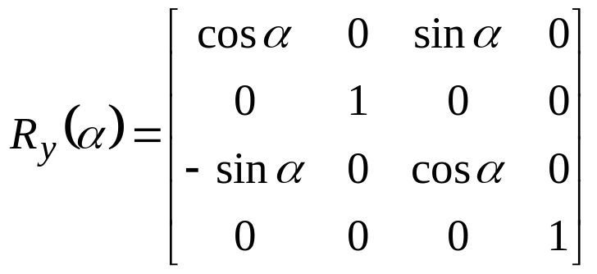
Rotation example (step 2a)
Step 2: Rotate to get line in coordinate plane
Rotate α about y to get p₂’ into xy plane
y
y
l
l
p₁’ = (0, 0, 0)
p₂’ = (1, 1, 1)
p₁’’ = (0, 0, 0)
p₂’’ = (?,?,?)
α
x
x
z
z

Slide 40
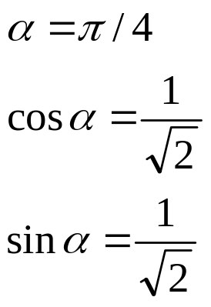
Rotation example (step 2b)
What is α?
Looking down the y axis:
p₁’ = (0, 0, 0)
So:
α
x
p₂’ = (1, 1, 1)
z

Slide 41
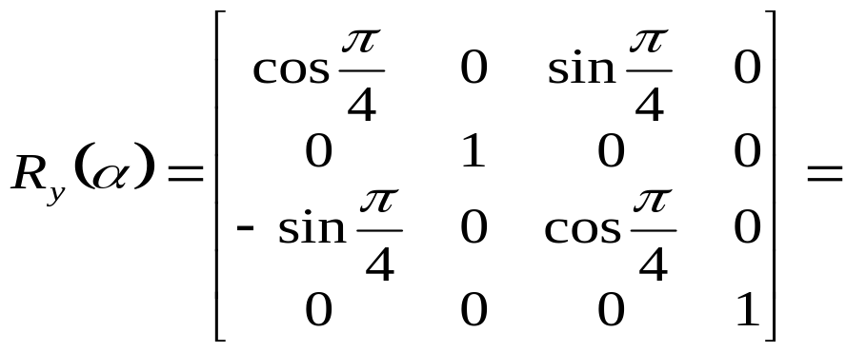
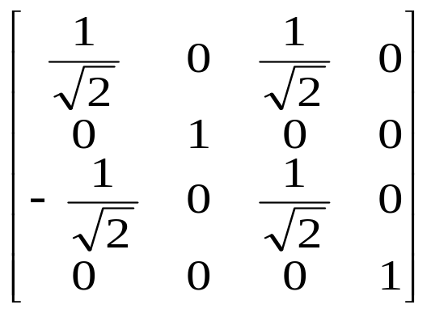
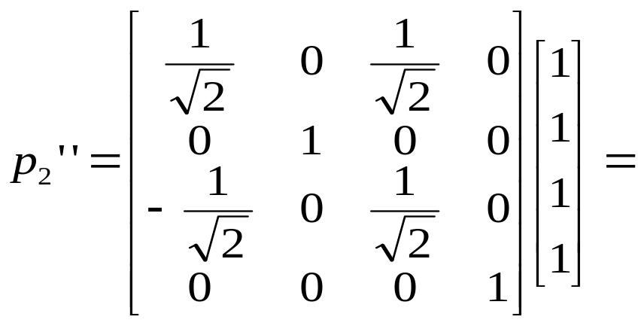
Rotation example (step 2c)
What is p₂’’?
If we apply the rotation matrix to p₂’, we get p₂’’

Slide 42

Rotation example (step 2d)
Giving:
y
l
x
z

Slide 43


Rotation example (step 3a)
Next, rotate about the z axis by β to put p₂ on the y axis
What angle is β?
y
l
y
l
β
x
x
z
z

Slide 44
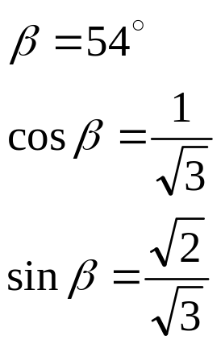
Rotation example (step 3b)
Looking down the z axis:
y
β
So:
p₁’ = (0, 0, 0)
x

Slide 45
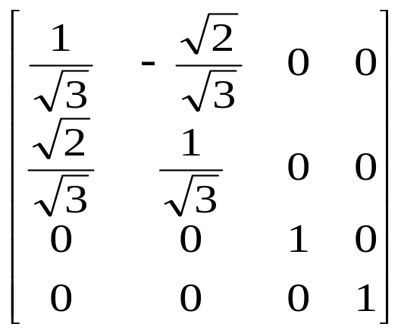
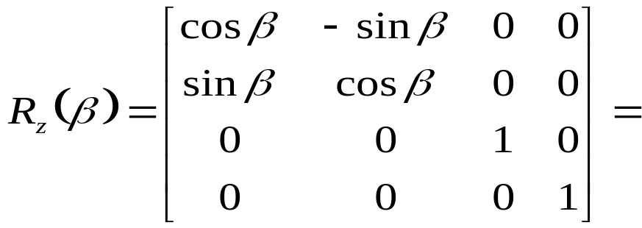
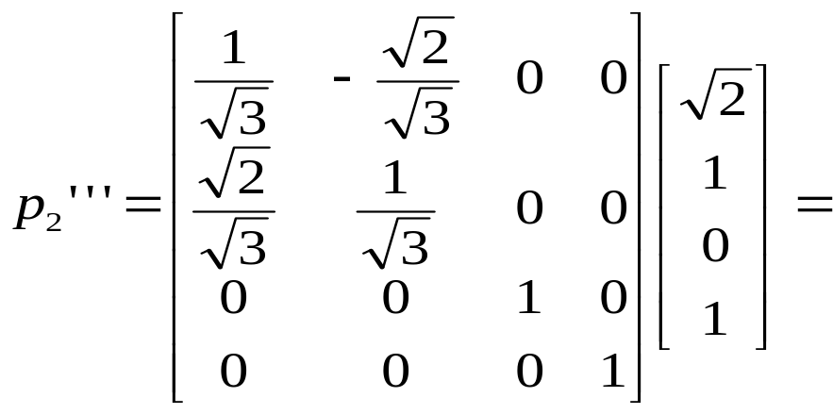
Rotation example (step 3c)
What is p₂’’’?
If we apply the rotation matrix to p₂’’, we get p₂’’’

Slide 46
Rotation example (step 3d)
Giving:
l
y
x
z

Slide 47
Rotation example (steps 4-7)
Step 4: Perform the desired rotation about the y axis
This is the rotation we originally desired to perform
Step 5: Rotate about the z axis an angle of -β
This will undo the z rotation performed earlier
Step 6: Rotate about the y axis an angle of -α
This will undo the y rotation performed earlier
Step 7: Translate by -T
This will move the object back to it’s appropriate location

Slide 48
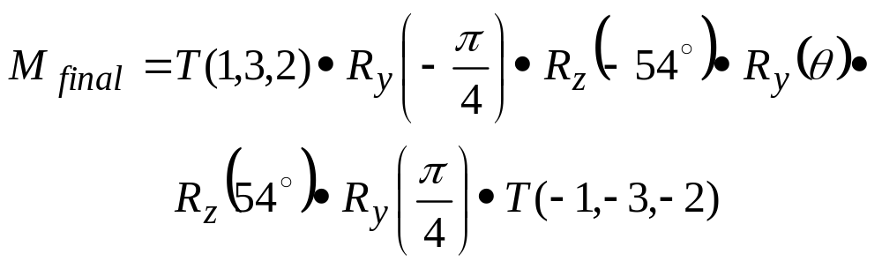
Rotation Example (final)
The final transformation matrix is:

Slide 49
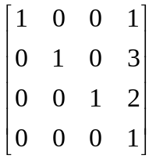
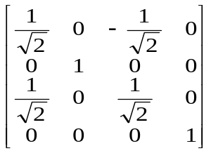
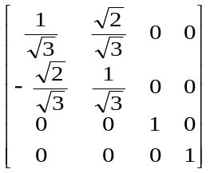
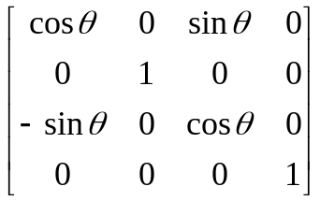
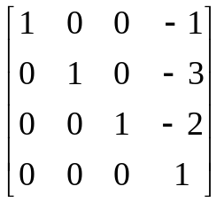
Rotation Example (final)
Or:

